Slide 1
Programming
About Facilino
Leopoldo Armesto
Senior Lecturer
Universitat Politècnica de València

Slide 2
Outline
About Facilino
License
How to get a free license.
Activating the license.
Programming with Blocks

Slide 3






About Facilino
Download:
Multi-platform support:
Supported hardware: Arduino Nano, Arduino Uno, Arduino Mega 2560, Arduino Micro, Arduino LilyPad, Arduino Mini, Arduino Leonardo, ESP8266 (includes NodeMCU and Wemos D1 R2), ESP32 (includes Wemos D1 R32)
Languages: English, Spanish, Català, Dansk, Deutsch, Euskera, Français, Galego, Italiano, Nederlands, Norsk, Polski, Portugues, Russian, Svenska
https://roboticafacil.es/en/download/
https://github.com/roboticafacil/facilino

Slide 4
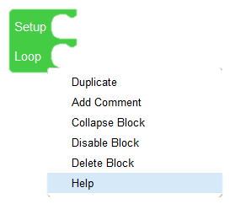
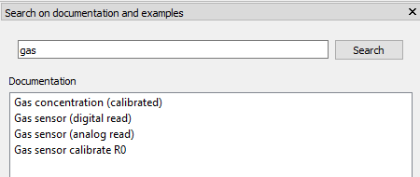
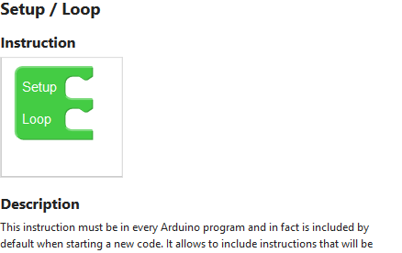
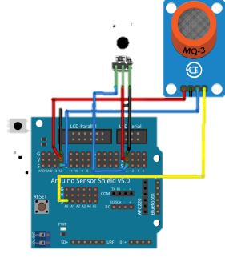
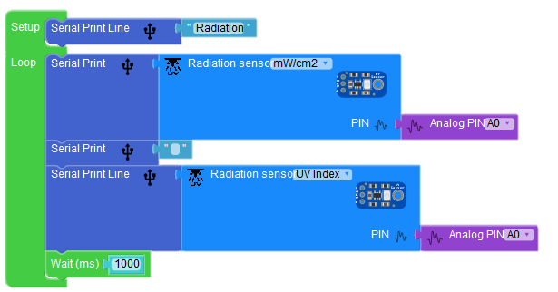
About Facilino
Documentation & Search: Every instruction is documented in English, Spanish and Català.
Examples: Every instruction comes with one or several examples with circuits and codes for several boards.

Slide 5
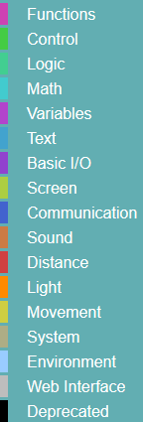
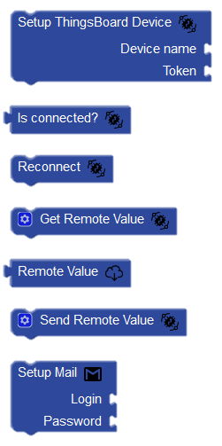
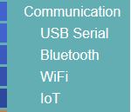
About Facilino
Categories & subcategories:
Show & Hide utility:

Slide 6


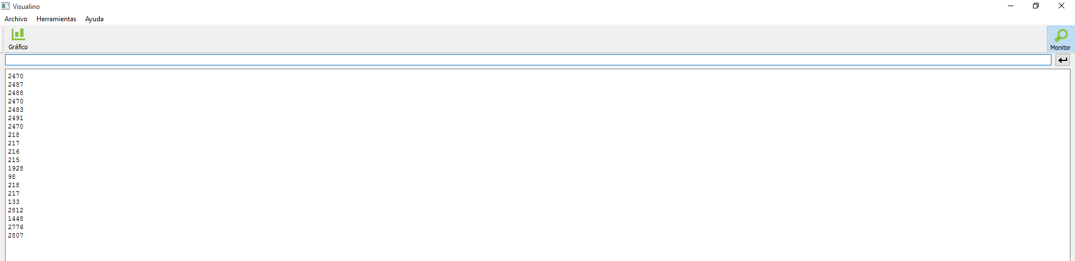
About Facilino
Instructions: More than 300 different instructions.
Verification & Upload: Select the appropriate processor and port.
Serial Monitor and Plot:

Slide 7
License
License can be acquired at Robótica Fácil store, a very small company, devoted to create and provide educational resources in UPV MOOCs:
Facilino license allows code generation for advanced instructions.
13-digit key that can be used on any platform and several computers (after 5 min). No shipping costs.
Uncountable hours devoted to improve this software. Collected money from the license is used for buying new materials to create new resources. Please contribute!

Slide 8
How to get a free license
We offer the license for free by purchasing materials at Robótica Fácil store.
Conditions to apply for a free license:
What we ask in exchange? To help us improving and disseminating Facilino
Translate some instructions in your native language.
Document some instructions in your native language.
Create original & educational examples.
Create original & educational blog entries.
https://roboticafacil.es/en/prod/facilino-license/

Slide 9
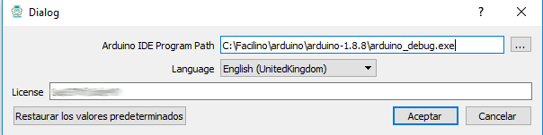


Activating the license
In Facilino preferences, introduce your license key:
You should see:
If it fails, reload your page to verify again the license.
If your license is not active, your code will show ‘//demo version’ for some blocks.

Slide 10
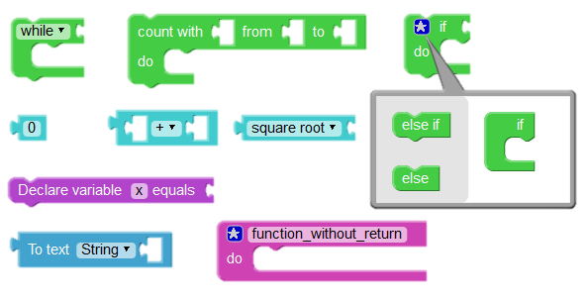
Programming with Blocks
Previous connection
Next connection

Slide 11
Programming with Blocks
Input
Statement input
Inline input
Output

Slide 12
Programming with Blocks
Dropdown list
Number field
Text field

Slide 13
Programming with Blocks
Mutator

Slide 14
Programming
About Facilino
Leopoldo Armesto
Senior Lecturer
Universitat Politècnica de València

